Slide 1
Molecular Phylogenetics of some endangered turtle species
Natalia Morozova

Slide 2
Data
Genbank
11 species:
5 sea turtles, 3 terrestrial, 2 freshwater and 1 aquasemiatic
Idea:
Molecular phylogenetics of some endangered turtles reveals new close genetic relationships (2023) DOI:10.26577/ijbch.2023.v16.i1.02

Slide 3
Methods
MAFFT and MUSCLE for alignment
NJ: phylip, F84, alpha=0.5
ML: IQTree
Bayesian: MrBayes

Slide 4
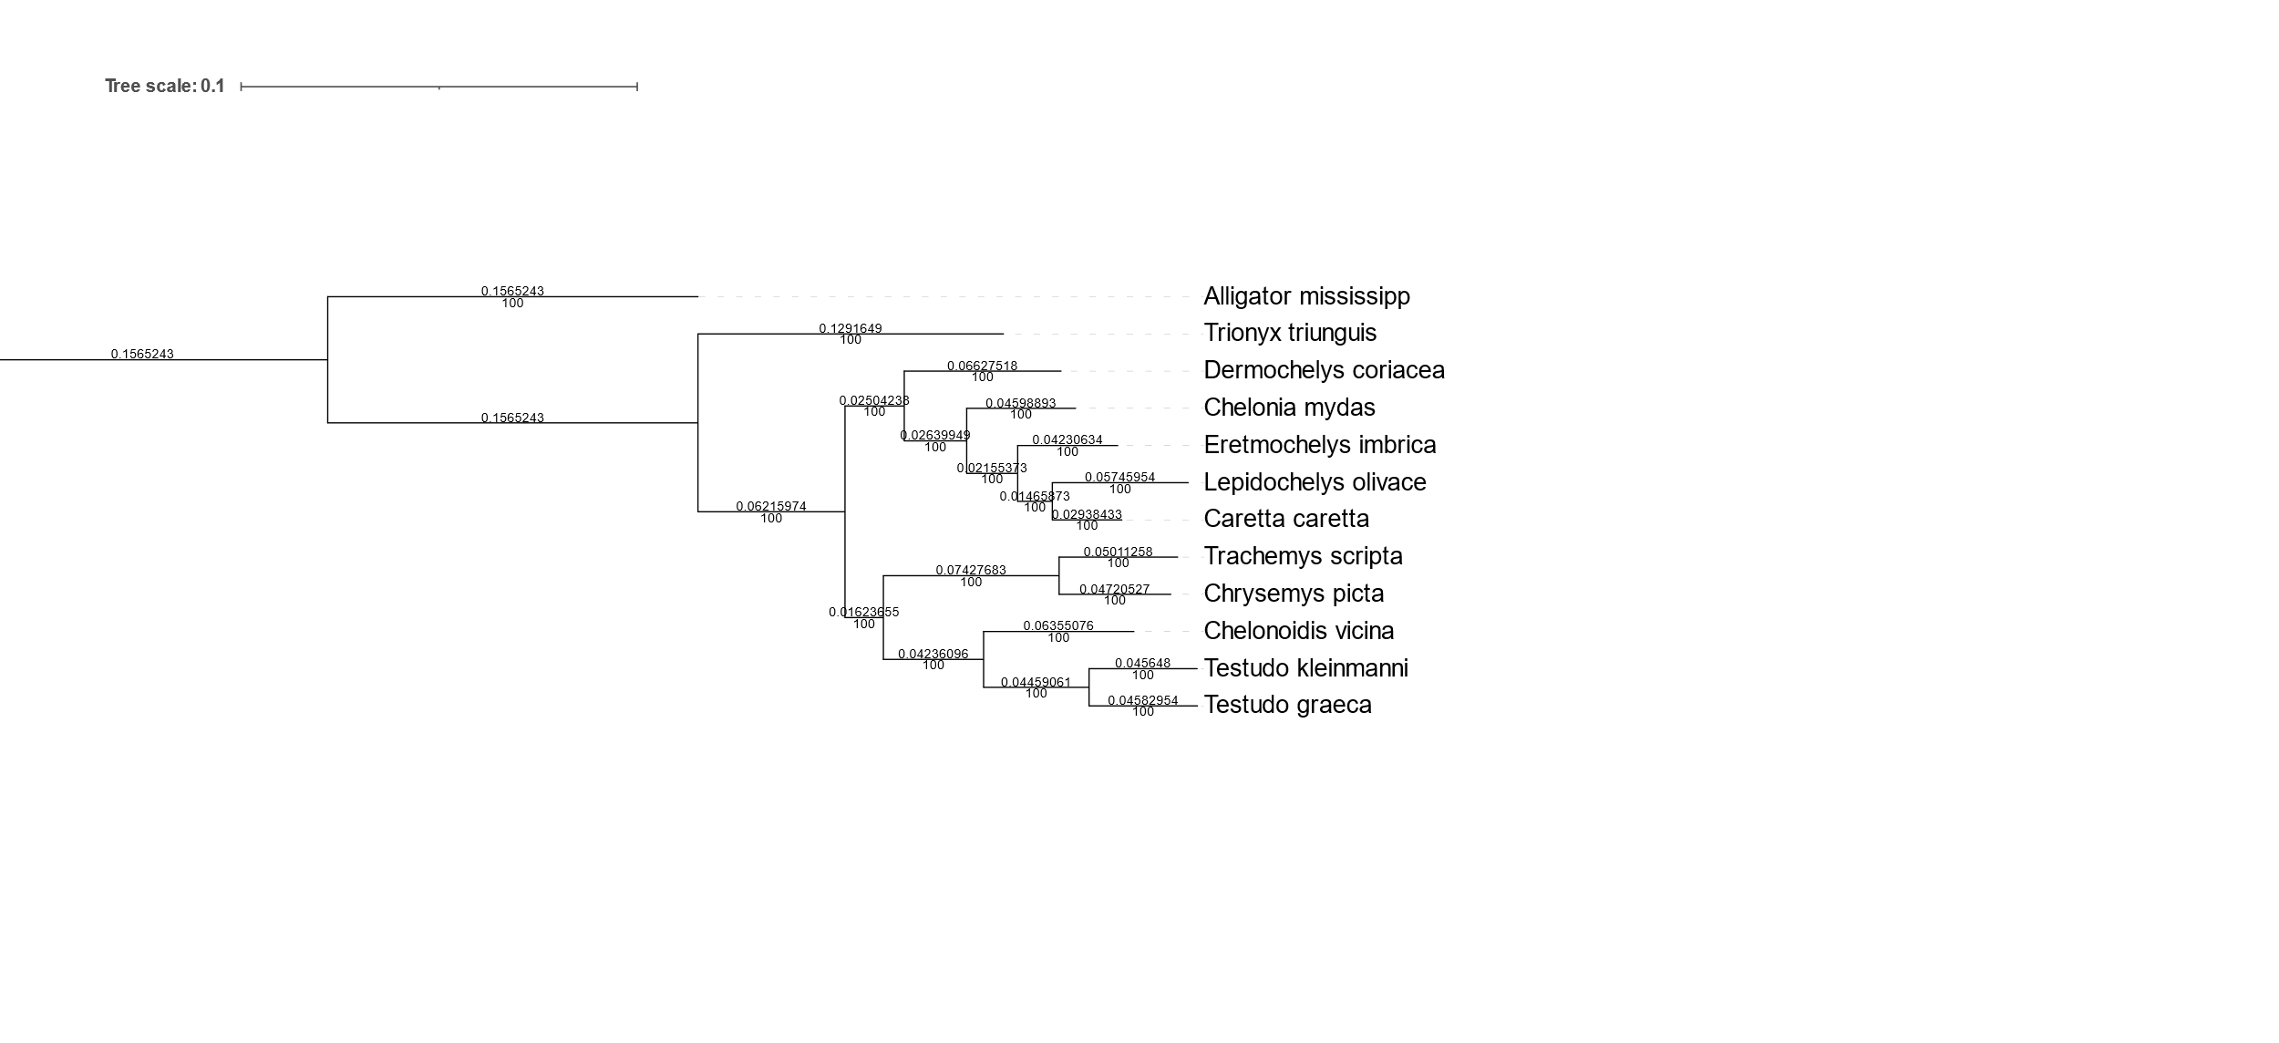
African softshell (freshwater)
Leatherback sea turtle
Sea turtles
American freshwater turtles
Tortoises

Slide 5
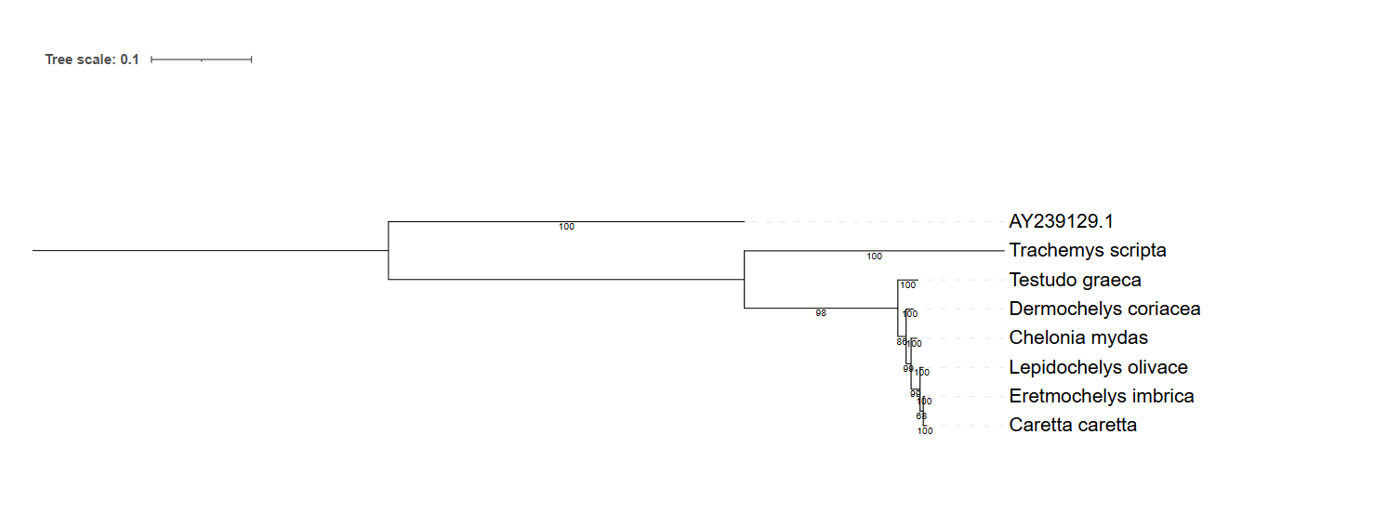
RAG-1

Slide 6
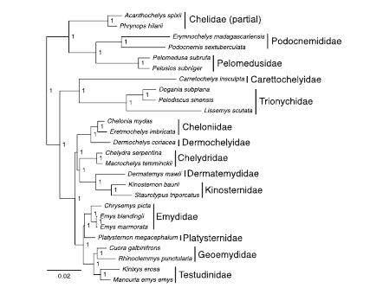
Phylogenomic analyses of 539 highly informative loci dates a fully resolved time tree for the major clades of living turtles (Testudines)
(2017)
(https://doi.org/10.1016/j.ympev.2017.07.006)

Slide 7
Thank you for your attention!

